Slide 1
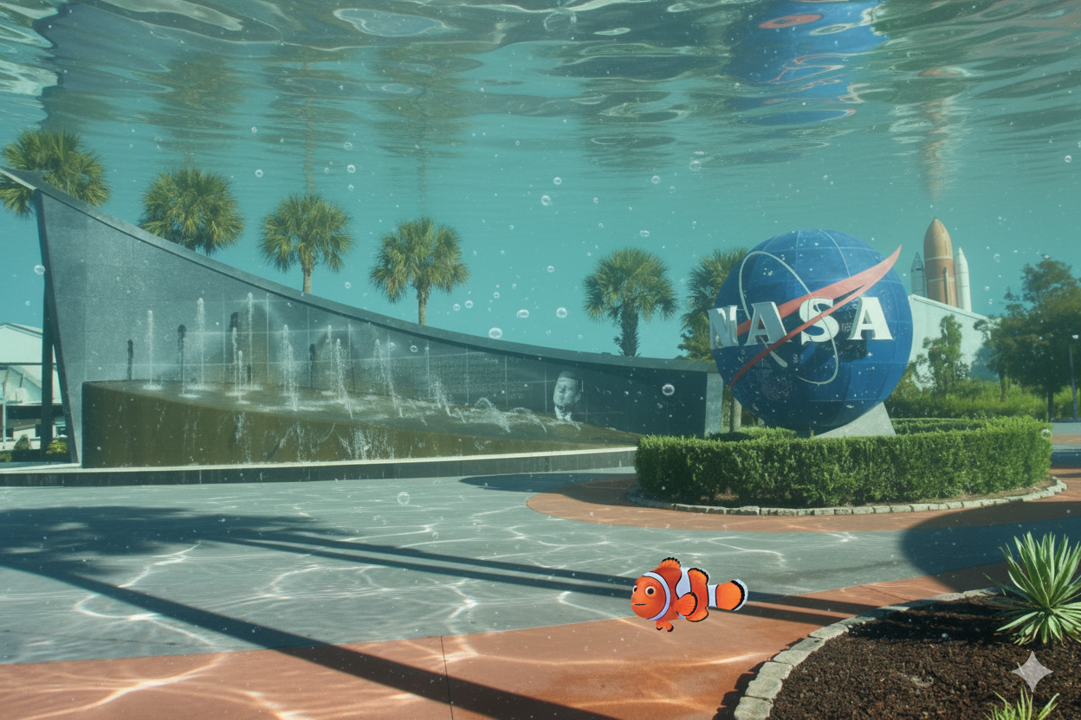

Slide 2
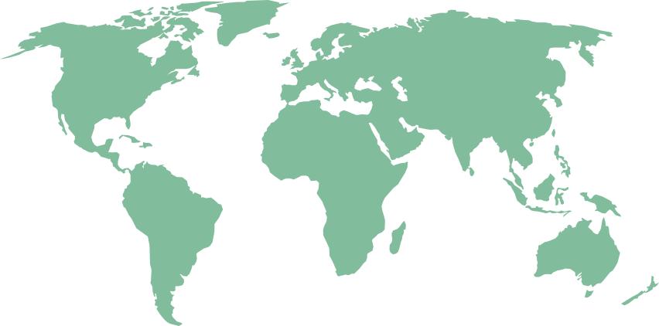


RECEDING COASTLINE

Slide 3



About us
We are a group of seniors from the Florida Institute of Technology who enjoy utilizing our skillset to create cool stuff.
YASH JANI
COMPUTER SCIENCE
EVAN GUNDERSON
COMPUTER SCIENCE
JOSHUA SHELDON
COMPUTER SCIENCE
KHURRAM VALIYEV
SOFTWARE ENGINEERING

Slide 4




Problem
Global warming has accelerated the melting of glaciers and ice has driven the sea levels to increase. This increase is already affecting many worldwide.
Flooding - High-tide flooding now 300% - 900% more frequent than it was 50 years ago! (NOAA)
Shoreline receding - receding causes erosion in beaches, which destroys habitats.
Community impact - coastal communities like Tuvalu are facing displacement, loss of homes, and a decrease in safety
Economic impact - Local economies that rely on beaches for tourism get destabilized, causing investors to hesitate and homeowners to abandon high-risk areas.

Slide 5

Solution
(1)
We trained a transformer on coastline position history from 1984 to now (40+ years) to predict the future of our coastlines
(2)
We developed a web app which allows the user to see how the coastline has changed over the last 40 years, and where it will be decades from now!

Slide 6
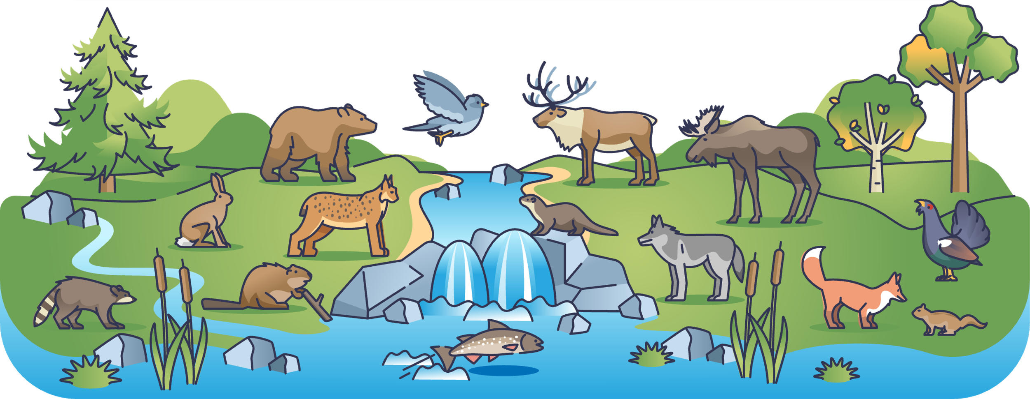
Demo!

Slide 7
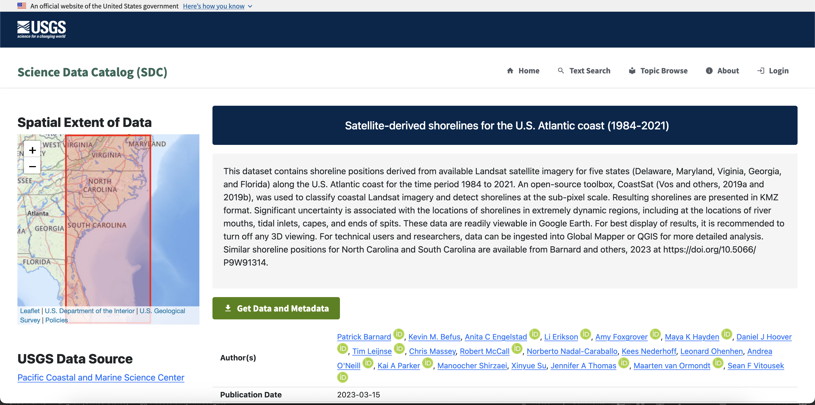
Data
Data produced using the CoastSat framework, which leverages satellite imagery to determine the position of the coast.
Each timestamp only updates fractions of the coast.
Updated portions are not consistent, meaning we had to employ latitudinal segmentation.

Slide 8


Novel features
To the best of our knowledge, we’re one of the first to apply transformers to coastline movement prediction.
Data is stored as a tree of bounding boxes, allowing us to load only the data the user wants to see at a manageable fidelity for the frontend.
The time slider allows the user to select a specific year they want to look at, be it in the past or the future.
The animation button allows the user to see the shift in the coastline with smooth year-to-year transitions.
The leaflet map allows the user to see where exactly on the map they are.

Slide 9



Impact
Makes the impact of the global warming crisis accessible and easy to visualize.
Empowers communities to determine if their homes are at risk.
Informs governments allocating mitigation and disaster relief funds, ensuring they can confidently determine which areas are most severely impacted

Slide 10


References
https://www.climate.gov/news-features/understanding-climate/climate-change-global-sea-level
https://data.usgs.gov/datacatalog/data/USGS:124b402e-dd8c-4e45-ac50-10ce6c8a083a

